Slide 1
NYC Real Estate- Baychester
Hsin Fang Hu
AD571 Prof. David Ritt

Slide 2
CONTENTS
AD571 Real Estate Analysis _ Hsin
Goal & Necessary Data
Model development & validation
Model deployment
Model monitoring & improvement
Company value
Next Step

Slide 3
1. Goal & Necessary Data

Slide 4
Business Goal & Model Goal
AD571 Real Estate Analysis _ Hsin
Whether to open up an office for the Baychester?
Predict the sales of Baychester in the next two years and calculate the possible value of the maximum profit.
our office
Necessary Data
This report will use the historical data table of real estate transaction data.

Slide 5
2. Model development & validation

Slide 6
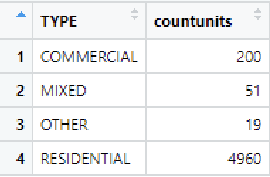
Neighborhood - Baychester
AD571 Real Estate Analysis _ Hsin
Total Sales Price
Sales Units

Slide 7
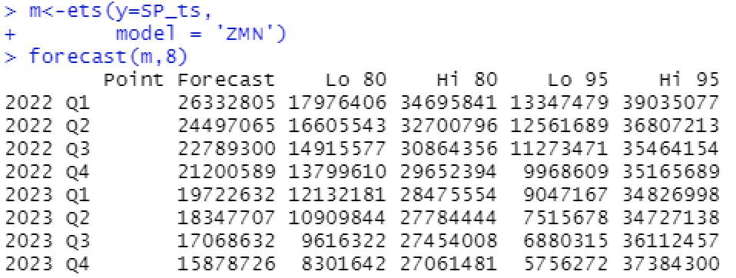
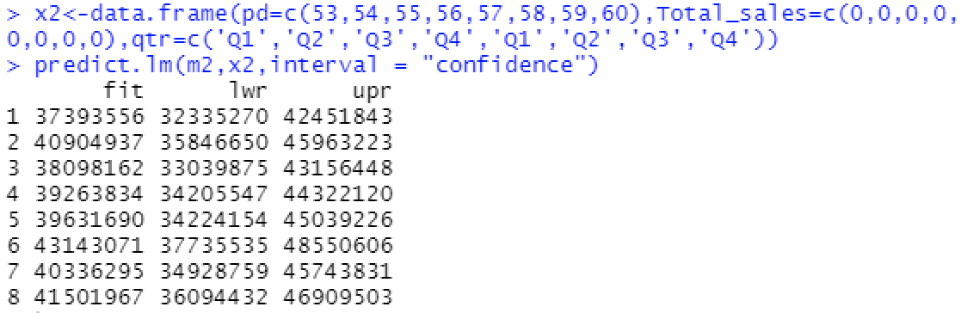
AD571 Real Estate Analysis _ Hsin
Time Series Model
Regression forecast Model – time predictor (R² = 0.64)

Slide 8
3. Model deployment

Slide 9
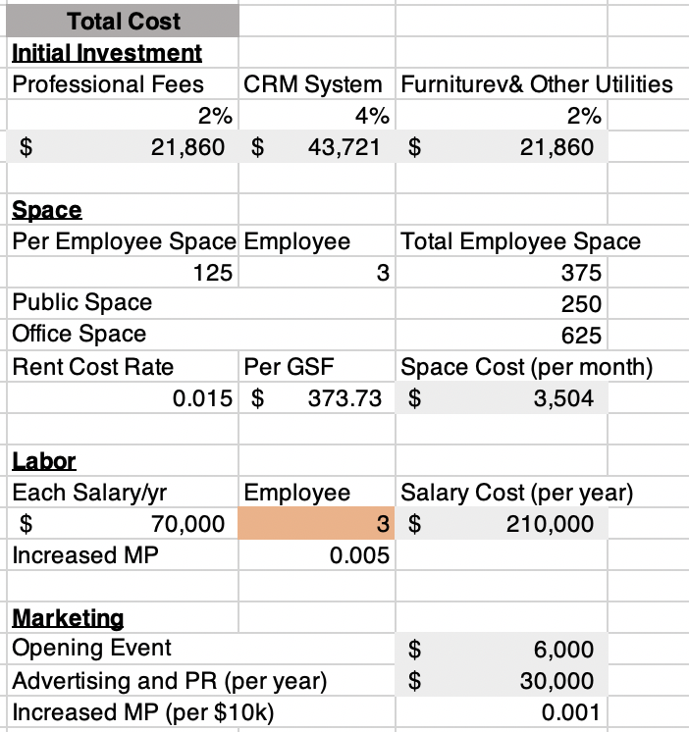
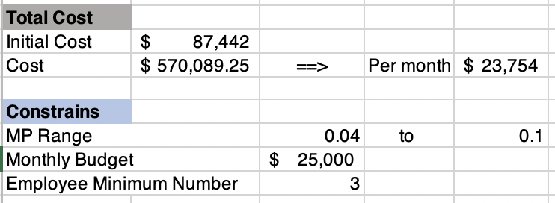
AD571 Real Estate Analysis _ Hsin
Optimization Model – Maximum Profit

Slide 10
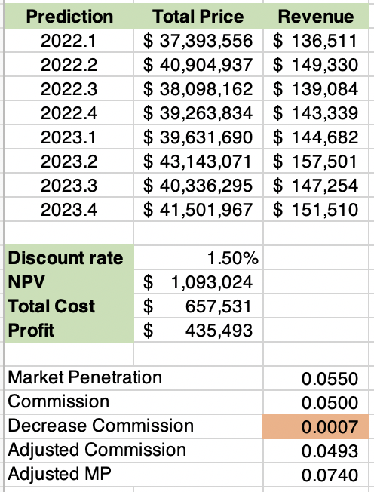
AD571 Real Estate Analysis _ Hsin
Revenue
Adjusted Market Penetration (MP)
= 5.5% + Increased MP% due to reduced commission + Increased MP% by hiring employees
+ Increased MP% through marketing spending
The greatest profit: Reducing the commission by 0.07% and have 3 employees.

Slide 11
4. Model monitoring & improvement

Slide 12
AD571 Real Estate Analysis _ Hsin
Monitoring
We can compare the actual sales figures in 2022 with the forecasted values, and first examine the accuracy of the forecasted values.
Then check the rationality of the market penetration rate and commission ratio, and fine-tune the ratio.
Improvement
With the previous monitoring data, we can improve the prediction model and optimization model. Making it feasible and profitable to open an office in Baychester.

Slide 13
5. Company Value

Slide 14
Contribution
AD571 Real Estate Analysis _ Hsin
Assessing neighborhood potential
At the beginning, we know that we have to focus on the residential type, and then evaluated whether Baychester has the potential to make profits through the sales forecast value and optimization model.
ROI rate
66.23%

Slide 15
6. Next Step

Slide 16
Choose Baychester?
AD571 Real Estate Analysis _ Hsin
Manpower
Considering the actual situation, if the company has only three employees, it may cause a shortage of manpower.
Potential risks
We should conduct a more detailed analysis of potential risks and changes in the current market environment.
Only then can we make the decision whether to open a real estate office in Baychester.

Slide 17
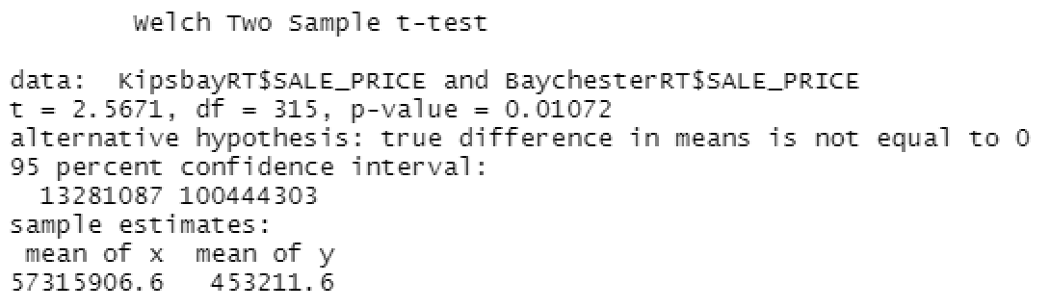
Other neighborhoods
AD571 Real Estate Analysis _ Hsin
In the chart and T-test, we can see that Kips Bay's average price of one square foot is much higher than Baychester.

Slide 18
Thank you

